Slide 1
Lagrangian Relaxation-2
CONTENTS:
A Decomposition Approach for LR
Subgradient Method
Relating LR to LP
READING ASSIGNMENTS:
Chap 16
Notes:
Obtain a network, and use the same network to illustrate the shortest path problem for communication networks, the max flow problem, the minimum cost flow problem, and the multicommodity flow problem. This will be a very efficient way of introducing the four problems. (Perhaps under 10 minutes of class time.)

Slide 2
The Constrained Shortest Path Problem
2
(1,1)
4
(1,10)
(2,3)
(1,7)
1
(1,2)
(10,1)
6
(5,7)
(10,3)
(2,2)
3
5
(12,3)
Find the shortest path from node 1 to node 6 with a transit time at most 10

Slide 3
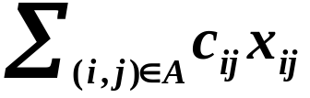
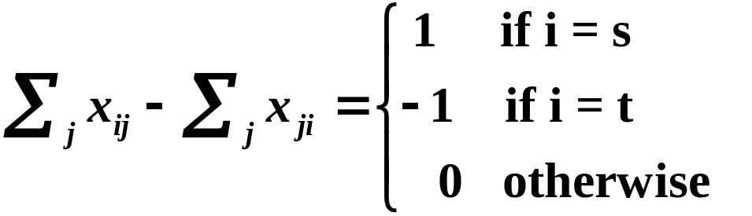
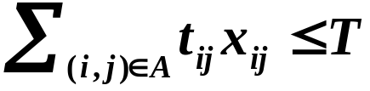

Constrained Shortest Paths: LP Formulation
Given: a network G = (N,A)
c_{ij} cost for arc (i,j)
t_{ij} traversal time for arc (i,j)
Z* = Min
s. t.
Complicating constraint

Slide 4
Lagrangian Relaxation and
Inequality Constraints
z* = min cx
subject to Ax ≤ b, (P)
x ∈ X.
L(μ) = min cx + μ(Ax - b) (P(μ))
subject to x ∈ X.
L* = max (L(μ) : μ ≥ 0).
So we want to maximize over μ, while we are minimizing over x.

Slide 5
An alternative representation
Suppose that X = {x¹, x², x³, …, x^{K}}. Possibly K is exponentially large; e.g., X is the set of paths from node s to node t.
L(μ) = min cx + μ(Ax - b) = (c + μA)x - μb
subject to x ∈ X.
L(μ) = min {(c + μA)x^{k} - μb : k = 1 to K}

Slide 6
Solving the Lagrange Multiplier Problem
L(μ) = min {(c + μA)x^{k} - μb : k = 1 to K }
Determine L* = max (L(μ) : μ ≥ 0}

Slide 7
Suppose we want the min cost path from 1 to 6 with transit time at most 14.
2
(1,1)
4
(1,10)
(2,3)
(1,7)
1
(1,2)
(10,1)
6
(5,7)
We now list all K paths from 1 to 6.
(10,3)
(2,2)
3
5
(12,3)
P
c_{P}
t_{P}
c_{P}+ μ (t_{P} – 14)
1-2-4-6
3
18
3 + 4 μ
1-2-5-6
5
15
5 + μ
1-2-4-5-6
14
14
14
etc.

Slide 8
Paths
30
1-3-4-6
1-2-4-6
20
1-3-4-5-6
1-2-4-5-6
10
1-2-5-6
Composite Cost
1-3-2-4-6
0
1-3-2-4-5-6
L* = max (L(μ): μ ≥ 0)
1-3-2-5-6
1-3-5-6
-10
0
1
2
3
4
5
Lagrange Multiplier μ
Figure 16.3 The Lagrangian function for T = 14.

Slide 9
Solving the Lagrange Multiplier Problem
L(μ) = min {(c + μA)x^{k} - μb : k = 1 to K }
In the algorithm S will be a subset of {1, 2, …, K}
Let L_{S}(μ) = min {(c + μA)x^{k} - μb : k ∈ S}
L_{S}(μ) ≥ L(μ).
So, L*_{S} ≥ L*.
Initialize S
Find μ* that maximizes L*_{S} = L_{S}(μ).
Find x^{k} ∈ X that minimizes (c + μ*A)x
If k ∈ S, quit with the optimal solution
Else, add k to S, and return to step 2.
At end,
L*_{S} = L_{S}(μ*)
= L(μ*)
≤ L*.

Slide 10
We start with the paths 1-2-4-6, and 1-3-5-6
which are optimal for L(0) and L(∞).
Paths
30
1-2-4-6
3 + 4 μ
20
2.1, 40.8
10
Composite Cost
0
1-3-5-6
24 - 6 μ
-10
0
1
2
3
4
5
Lagrange Multiplier μ

Slide 11
Set μ = 2.1 and solve the constrained shortest path problem
The optimum path is 1-3-2-5-6
length=15 - 4 μ
2
3.2
4
22
8.3
15.7
1
5.2
12.1
6
19.7
16.3
6.2
3
5
18.3

Slide 12
Add Path 1-3-2-5-6 and reoptimize
Paths
30
1-2-4-6
3 + 4 μ
20
10
Composite Cost
1.5, 9
0
15 - 4 μ
1-3-2-5-6
1-3-5-6
24 - 6 μ
-10
0
1
2
3
4
5
Lagrange Multiplier μ

Slide 13
Set μ = 1.5 and solve the constrained shortest path problem
The optimum path is 1-2-5-6.
2
2.5
4
16
6.5
11.5
1
4
11.5
6
15.5
14.5
5
3
5
16.5

Slide 14
Add Path 1-2-5-6 and reoptimize
Paths
30
1-2-4-6
3 + 4 μ
20
1-2-5-6
5 + μ
10
Composite Cost
2, 7
0
15 - 4 μ
1-3-2-5-6
1-3-5-6
24 - 6 μ
-10
0
1
2
3
4
5
Lagrange Multiplier μ

Slide 15
Set μ = 2 and solve the constrained shortest path problem
The optimum paths are
1-2-5-6 and
1-3-2-5-6
2
3
4
21
8
15
1
5
12
6
19
16
6
3
5
18

Slide 16
There are no new paths to add.
μ* is optimal for the multiplier problem
Paths
30
1-2-4-6
3 + 4 μ
20
1-2-5-6
5 + μ
10
Composite Cost
2, 7
0
15 - 4 μ
1-3-2-5-6
1-3-5-6
24 - 6 μ
-10
0
1
2
3
4
5
Lagrange Multiplier μ

Slide 17
Solving the Lagrange Multiplier Problem
L(μ) = min {(c + μA)x^{k} - μb : k = 1 to K }
Let S be a subset of {1, 2, …, K}
Let L_{S}(μ) = min {(c + μA)x^{k} - μb : k ∈ S}
L_{S}(μ) ≥ L(μ).
So, L*_{S} ≥ L*.
Initialize S
Find μ* that maximizes L*_{S} = L_{S}(μ).
Find x^{k} ∈ X that minimizes (c + μ*A)x
If k ∈ S, quit with the optimal solution
Else, add k to S, and return to step 2.
At end,
L*_{S} = L_{S}(μ*)
= L(μ*)
≤ L*.

Slide 18
Solving the Lagrange Multiplier Problem
Let L_{S}(μ) = min {(c + μA)x^{k} - μb : k ∈ S}
Find μ* that maximizes L_{S}(μ).
  This is a linear program (see next slide)
Find x^{k} ∈ X that minimizes (c + μ*A)x
  This is optimizing over X
Usually X is chosen so that optimizing over X is something that “easy” to do
  e.g., finding a minimum cost spanning tree
  or finding a minimum cost flow

Slide 19
Determining L*_{S} by solving an LP
min (a₁, a₂, …, a_{n}) = max { w : w ≤ a_{j} for j = 1 to n }
min (4, 9, 3) = max { w : w ≤ 4; w ≤ 9; w ≤ 3 }.
L_{S}(μ) = min {(c + μA)x^{k} - μb : k ∈ S}
L_{S}(μ) = max {w : w ≤ (c + μA)x^{k} - μb for k ∈ S}
L*_{S} = max w
w ≤ (c + μA)x^{k} - μb for k ∈ S
μ ≥ 0

Slide 20
Theorem 16.5
The Lagrangian multiplier problem L* = max _{μ} L(μ) with
L(μ) = {min cx + μ(Ax - b) : x ∈ X} is equivalent to the
linear programming problem:
L* = max w
w ≤ (c + μA)x^{k} - μb for k = 1 to K
μ ≥ 0

Slide 21
Subgradient optimization
Another major solution technique for solving the Lagrange Multiplier Problem is subgradient optimization.
Based on ideas from non-linear programming.
It converges (often slowly) to the optimum.
See the textbook for more information.

Slide 22
Application
Embedded Network Structure
Networks with side
constraints
minimum cost flows
shortest paths
Traveling Salesman
Problem
assignment problem
minimum cost spanning tree
Vehicle routing
assignment problem
variant of min cost spanning tree
Network design
shortest paths
Two-duty operator
scheduling
shortest paths
minimum cost flows
Multi-time
production planning
shortest paths / DPs
minimum cost flows

Slide 23




Lagrangian Relaxation and LPs
Theorem 16.6. Suppose that we apply the Lagrangian relaxation technique to solving a linear program P’ defined as
P’
By relaxing the constraint Ax = b. Then the optimal value L* of the Lagrangian multiplier problem equals the optimal objective value of P’.
Proof. See AMO.

Slide 24
On Lagrangian Relaxation and LPs
Advantage of solving the Lagrangian Relaxation
The relaxed problem may be much easier to solve
The relaxed problem may decompose into smaller problems
Comment on Theorem 16.6
We will use it to develop a stronger result on Lagrangian Relaxations based on convex hulls.

Slide 25
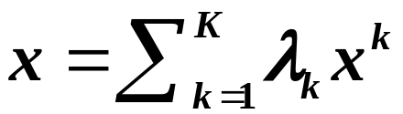
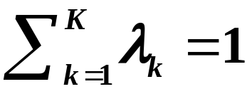

Convex Hulls
Suppose that X = {x¹, x², …, x^{K}} is a finite set.
Vector x is a convex combination of X = {x¹, x², …, x^{K}} if there is a feasible solution to
The convex hull of X is H(X) = { x : x can be expressed as a convex combination of points in X.}

Slide 26
Convex Hulls in two dimensions
The convex Hull H(X) is the smallest LP feasible region that contains all points of X.

Slide 27
Property 16.7
The set H(X) is a polyhedron, that is, it can be expressed as H(X) = {x : Ax ≤ b} for some matrix A and vector b.
Each extreme point of H(X) is in X. If we minimize {cx : x ∈ H(X)}, the optimum solution lies in X.
Suppose X ⊆ Y = {x : Dx ≤ c and x ≥ 0}.
Then H(X) ⊆ Y.

Slide 28


Theorem 16.8
The optimal objective function value L* of the Lagrangian multiplier problem equals the optimal objective function value of the linear program
P*
P
First, note that P* ≠ P

Slide 29
max x₁
s.t.
x₁ – x₂ ≤ 1
x ∈ H(X)
is different from
max x₁
s.t.
x₁ – x₂ ≤ 1
x ∈ X
x₁

Slide 30


Theorem 16.8. The optimal objective function value L* of the Lagrangian multiplier problem equals the optimal objective function value of the linear program P*.
P*
Proof. For multiplier μ, the Lagrangian Relaxation is:
which by Property 16.7 is equivalent to:
(16.2)

Slide 31
(16.2)
(16.2) can be expressed as a linear program.
Moreover, (16.2) is a Lagrangian relaxation for:
P*
By Theorem 16.6, the optimal solution for the Lagrangian multiplier problem for P is equal to the optimal solution value for P*.

Slide 32










Theorem 16.9
Suppose we solve the Lagrangian multiplier problem for
Proof.
Then z⁰ ≤ L*, where

Slide 33
An Example of Theorem 16.9
The feasible region for Dx ≤ q, x ≥ 0
The feasible region for x ∈ H(X)
The feasible points for
Dx ≤ q, x ≥ 0,
x integer
are in black.

Slide 34



Integrality Property
Suppose X = {x : Dx ≤ q , x ≥ 0, x integer}.
We say that X satisfies if the integrality property if the following LP has integer solutions for all d
Fact: if X satisfies the integrality property then
min (dx: Dx ≤ q , x ≥ 0)
= min (dx : x ∈ X)
= min (dx : x ∈ H(x))

Slide 35
Theorem 16.10
If the Lagrangian subproblem of the optimization problem P satisfies the integrality property then
L* = z⁰, the solution to the LP relaxation of P.

Slide 36
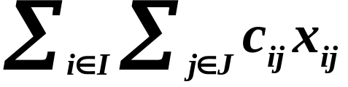
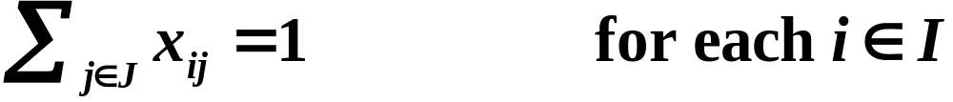
Example: Generalized Assignment
Minimize
(16.10a)
(16.10b)
(16.10c)
(16.10d)
If we relax (16.10c), the bound for the Lagrangian multiplier problem is the same as the bound for the LP relaxation.
If we relax (16.10b), the LP does not satisfy the integrality property, and we should get a better bound than z⁰.

Slide 37
Summary
A decomposition approach for Lagrangian Relaxations
Relating Lagrangian Relaxations to LPs

